Slide 1
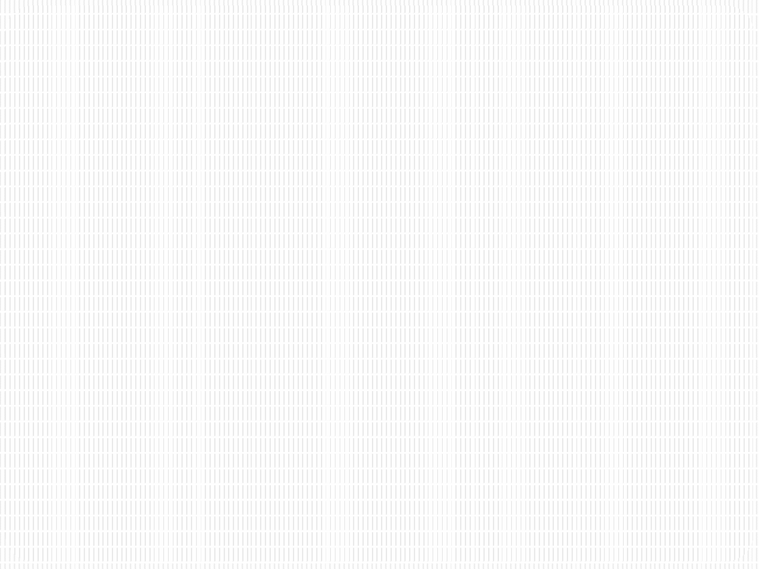


SRM INSTITUTE OF SCIENCE AND TECHNOLOGY
18CSC201J – Data Structures and Algorithms
Unit III- STACK & QUEUE

Slide 2
SESSION 1

Slide 3
STACK ADT
Abstract Data Type (ADT)
It is a mathematical model for data types
An abstract data type is defined by its behavior (semantics) from the point of view of a user, of the data, specifically in terms of possible values, possible operations on data of this type, and the behavior of these operations. Set of values and set of operations
A stack is an ADT
It follows Last In First Out (LIFO) methodology perform operations push, pop, etc.

Slide 4
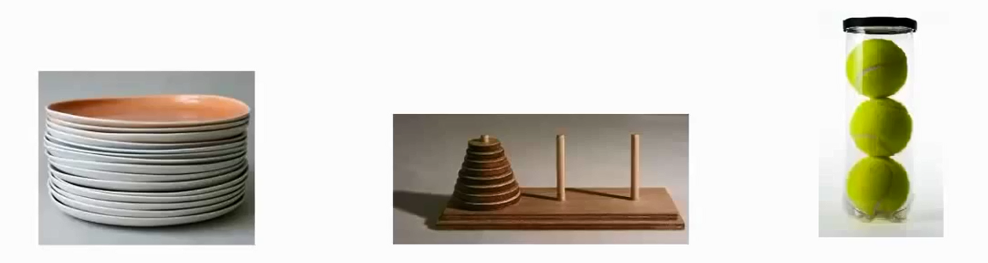
What is STACK?
Diagram Reference : http://www.firmcodes.com/write-a-c-program-to-implement-a-stack-using-an-array-and-linked-list/
Stack works on “Last in First out” or “First in Last Out”, principle.
Plates placed one over another
The plate at the top is removed first & the bottommost plate kept longest period of time.
So, it follows LIFO/FILO order.

Slide 5
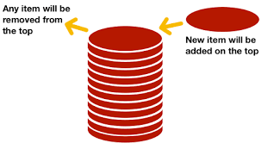
Stack Example
Diagram Reference:https://www.codesdope.com/course/data-structures-stacks/
Always new items are added at top of the stack and also removed from the top of the stack only.
Entry and Exit at same point

Slide 6
STACK – Data Structure
Stack is a Linear Data Structure
Follows a particular order to perform the operations.
The order are either
LIFO(Last In First Out)
OR
FILO(First In Last Out).

Slide 7
STACK - Operations
TWO PRIMARY OPERATIONS
push
Pushing (storing) an element on the stack
If the stack is full, Overflow condition is enabled.
Pop
Removing (accessing) an element from the stack.
The elements are popped in the decreasing order.
If the stack is empty, Underflow condition enabled.

Slide 8
STACK – Additional Functionality
For effective utilization of the stack, Status of the stack should be checked. For that additional functionality is of the stack is given below
Peek or Top
Accessing the top element. Without removing the top element.
isFull
check if stack is full.
isEmpty
check if stack is empty.

Slide 9
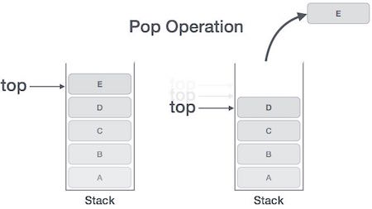
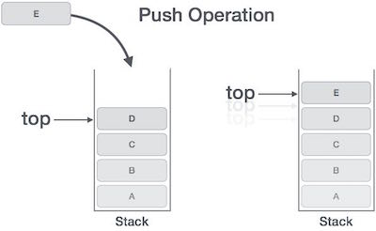
Stack Operation Example

Slide 10
Stack Implementation - Array

Slide 11
Stack - Array
One dimensional array is enough to implement the stack
Array size always fixed
Easy to implement
Create fixed size one dimensional array
insert or delete the elements into the array using LIFO principle using the variable 'top‘

Slide 12
Stack - top
About top
Initial value of the top is -1
To insert a value into the stack, increment the top value by one and then insert
To delete a value from the stack, delete the top value and decrement the top value by one

Slide 13
Steps to create an empty stack
Declare the functions like push, pop, display etc. need to implement the stack.
Declare one dimensional array with fixed size
Declare a integer variable 'top' and initialize it with '-1'. (int top = -1)

Slide 14
push(Value) Inserting value into the stack
push() is a function used to insert a new element into stack at top position.
Push function takes one integer value as parameter
Check whether stack is FULL based on (top == SIZE-1)
If stack is FULL, then display "Stack is FULL Nota able to Insert element” and terminate the function.
If stack is NOT FULL, then increment top value by one (top=top+1) and set (stack[top] = value)

Slide 15
pop() – Delete a value from the Stack
pop() is a function used to delete an element from the stack from top position
Pop function does not take any value as parameter
Check whether stack is EMPTY using (top == -1)
If stack is EMPTY, then display "Stack is EMPTY No elements to delete" and terminate the function
If stack is NOT EMPTY, then delete stack[top] and decrement top value by one (top=top-1)

Slide 16
display() Displays the elements of a Stack
display() – function used to Display the elements of a Stack
Check whether stack is EMPTY based on (top == -1)
If stack is EMPTY, then display "Stack is EMPTY" and terminate the function
If stack is NOT EMPTY, display the value in decreasing order of array

Slide 17
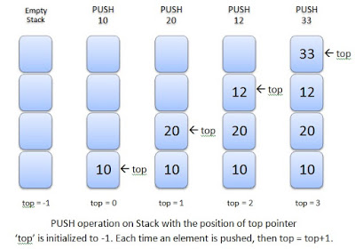
Stack Push Example
Diagram reference :http://www.exploredatabase.com/2018/01/stack-abstract-data-type-data-structure.html

Slide 18
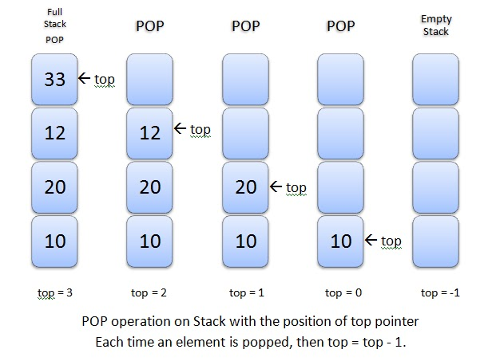
Stack Pop Example

Slide 19
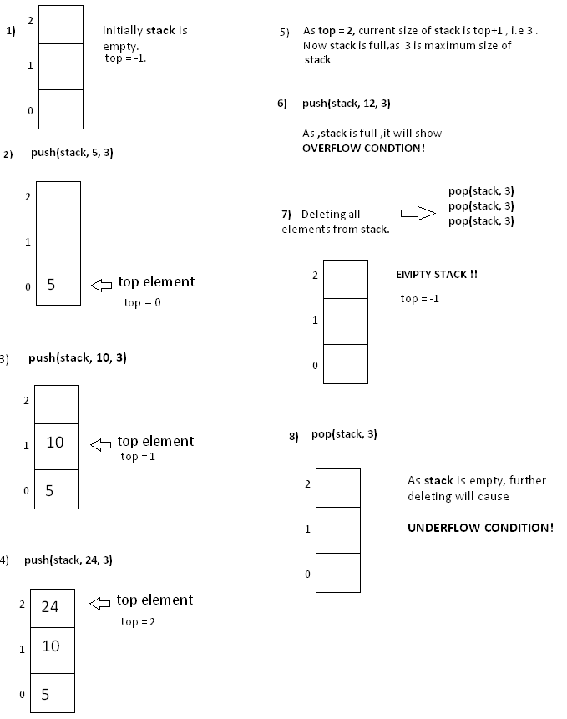
Another Example of Stack Push & Pop
Image Reference : https://www.hackerearth.com/practice/notes/stacks-and-queues/

Slide 20
Cons Stack - Array
The size of the array should be mentioned at the beginning of the implementation
If more memory needed or less memory needed that time this array implementation is not useful

